Slide 1
Teaching Fundamentals:
From Concept to Classroom
Ana-Marija Petrunic
Continuing education
University of Calgary
October 2015

Slide 2

Teaching Language and Culture
Assumptions
Generalizations
Insights

Slide 3
Opinions about Language Learning
Popular beliefs about how languages are learned
Adapted from:
Lightbown, P.S. & Spada, N. (1998). How Languages are learned. Oxford: OUp

Slide 4
agree or disagree
1 – Languages are learned mainly through imitation.
2 – The most important factor in second language acquisition success is motivation.
3 – The earlier a second language is introduced in school programs, the greater the likelihood of success in learning.
4 – Most of the mistakes which second language learners make are due to interference from their first language.
5 – strongly agree
4 – agree
3 – unsure
2 – disagree
1 – strongly disagree

Slide 5
agree or disagree
5 – Teachers should teach simple language structures before complex ones.
6 – Teachers should use materials that expose students only to those language structures which they have already been taught.
7 – When learners are allowed to act freely, they learn each other’s mistakes.
8 – Students learn what they are taught.
5 – strongly agree
4 – agree
3 – unsure
2 – disagree
1 – strongly disagree

Slide 6
Personal Teaching Methods
What you believe about what language is
How people learn
How teaching helps people learn

Slide 7
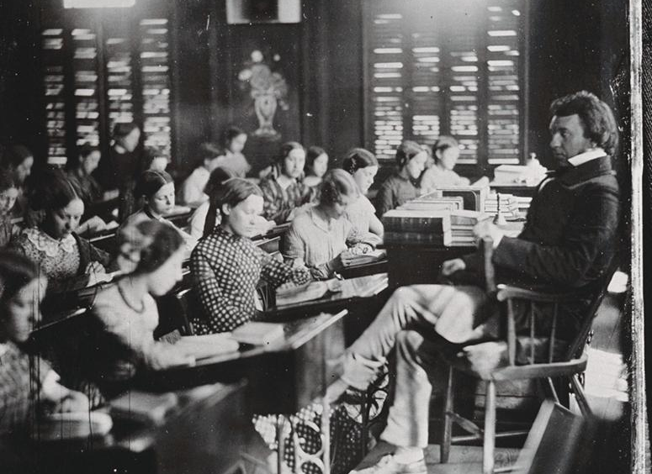
Teaching Fundamentals
Understanding Curriculum
Designing Lesson Aims
Staging a Lesson
Assessing the Learner

Slide 8
Understanding Curriculum
Imagine the class before it happens
Predict, anticipate, sequence, organize and simplify

Slide 9
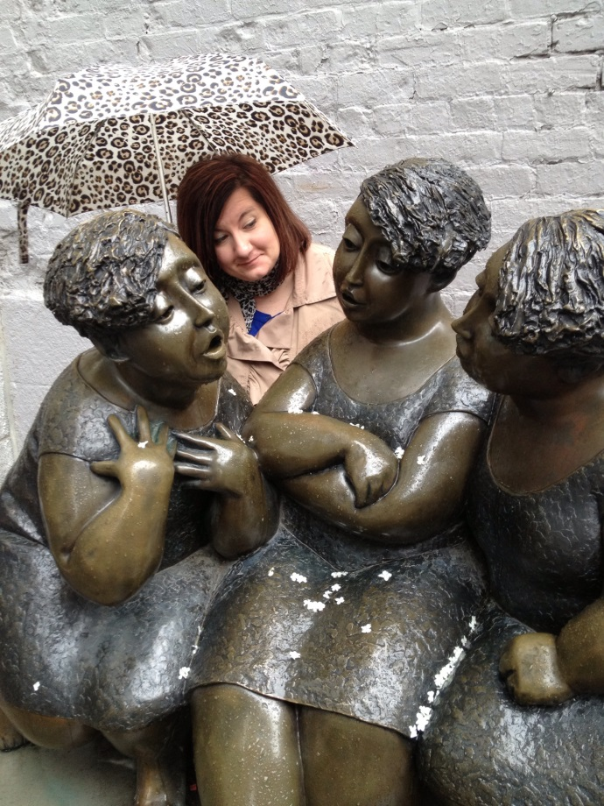
Understanding Curriculum
LEARNERS
PLAN
Sample
Speaking & Listening Syllabus and Curriculum Guide
Level 1 – High Beginner

Slide 10
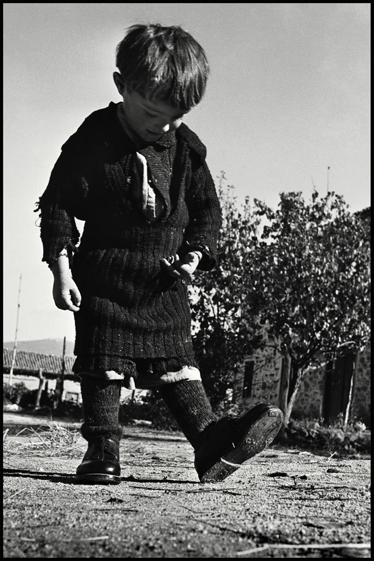
Planning is a Thinking Skill
Atmosphere
Learners
Aims
Teaching Point
Teaching Procedures
Challenges
Materials
Classroom Management

Slide 11
Designing Lesson Aims
What students will do in class
What the teacher hopes the students will achieve

Slide 12

Lesson Aims:
Achievement or Procedural?
Achievement:
The learners will be able to…
identify, describe, provide, exchange, ask, express, discuss
Procedural:
The learners will do/make..
a role play, a discussion, a speech, a song, an essay, a presentation

Slide 13
Staging a Lesson
Helping students get ready to learn
Facilitating active learning
Reflecting upon, extending and evaluating learning

Slide 14
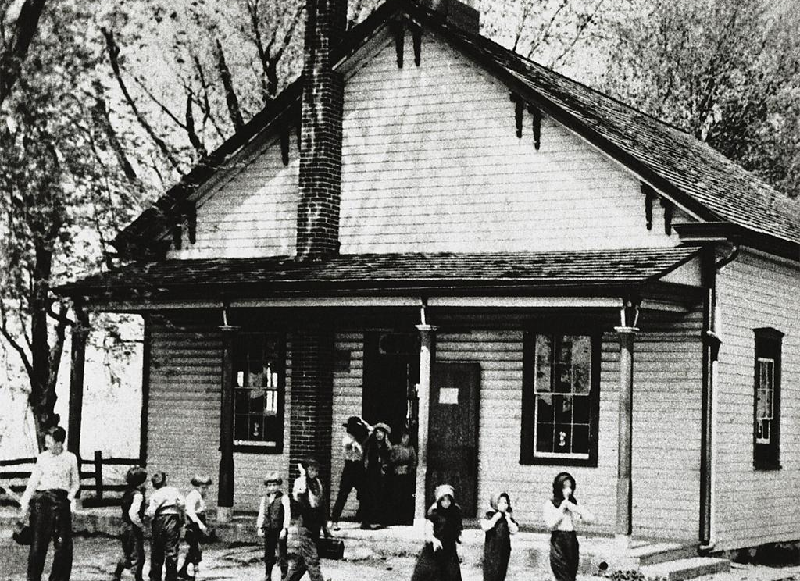
Activity Route Map:
Sample Lesson Plan 1
Anticipatory Phase:
Before the lesson
Lead-In/Preparation
Activity Set-Up
Realization Phase:
Running the Activity
Contemplative Phase:
Closing the Activity
Post-Activity

Slide 15
Assessing the Learner
What counts as learning?
What can learners do now?
What do learners still need to improve or learn?

Slide 16
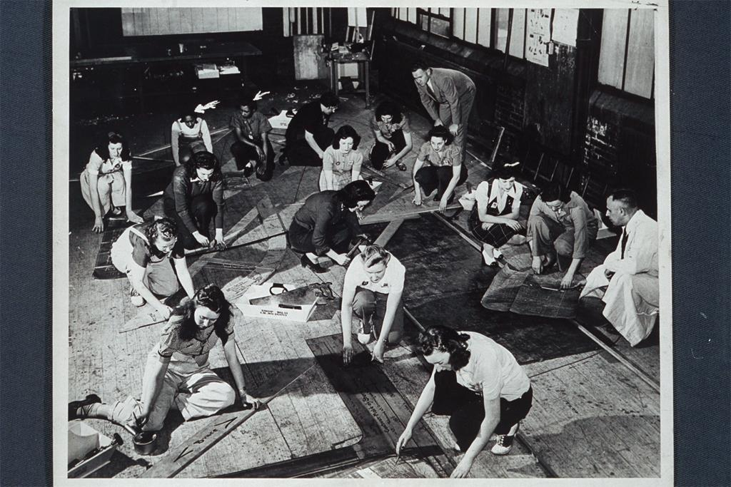
Learning Fundamentals
Learning Styles and Motivation
Learner Strategies
Learner Roles

Slide 17
Learning Styles and Motivation
What motivates learners
What implications individual differences have for the teacher

Slide 18

Learner Motivational Factors:
The 16 Steps
External Motivation:
Learners are studying language to…
pass an exam, get a promotion, enter university, please parents
Internal Motivation:
Learners are studying language to…
have fun, meet friends, set a challenge, try something new

Slide 19
Multiple Intelligence Theory
Learning Styles
Body/
Kinesthetic
Visual/
Spatial
Logical/
Mathematical
Verbal/
Linguistic
Musical/
Rhythmic
Naturalist
Inter-
personal
Intra-
personal

Slide 20
Learner Strategies
What is my role as a language teacher?
How do I help learners use strategies?

Slide 21
Learner Strategies in Second Language Learning
Metacognitive
Cognitive
Planning for learning
Thinking about learning
Monitoring production
Evaluating learning
Manipulating the learning material
directly

Slide 22
Learner Roles
What role does the learner have?

Slide 23
Learner Roles
The Learner
Aptitude
Attitude
Empathy
Motivation

Slide 24
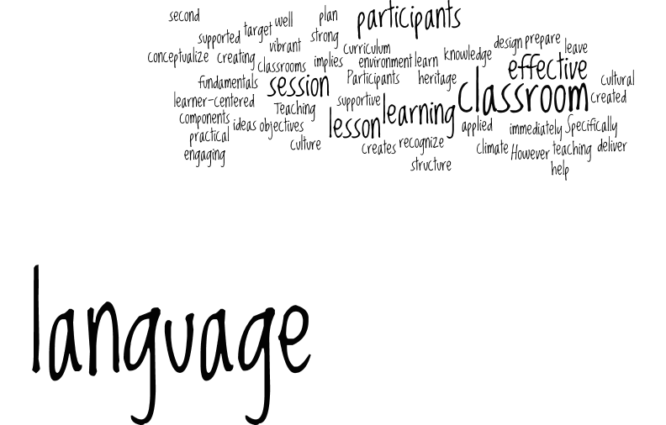
Reflection and Conclusion:
PMI Cards
Teaching Fundamentals:
From Concept to Classroom
Ana-Marija Petrunic
ampetrun@ucalgary.ca

